Slide 1
Designing for Surface HUB
Dr. Neil Roodyn
Jackie Giusti
Notes:
Motion sickness issue

Slide 2
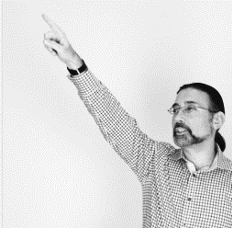

Presenter Intro
Dr. Neil Roodyn
A founder, entrepreneur, consultant, trainer and author
Jackie Giusti
Design Lead & Software Engineer
Developer Experience Team
Notes:
Introduce ourselves

Slide 3
Welcome!
Introduction
Design Overview
Tutorials
Notes:
Sankar to ask: Today we are doing this presentation, but this is part of a larger series right?
Dr. Neil to talk through the slide

Slide 4
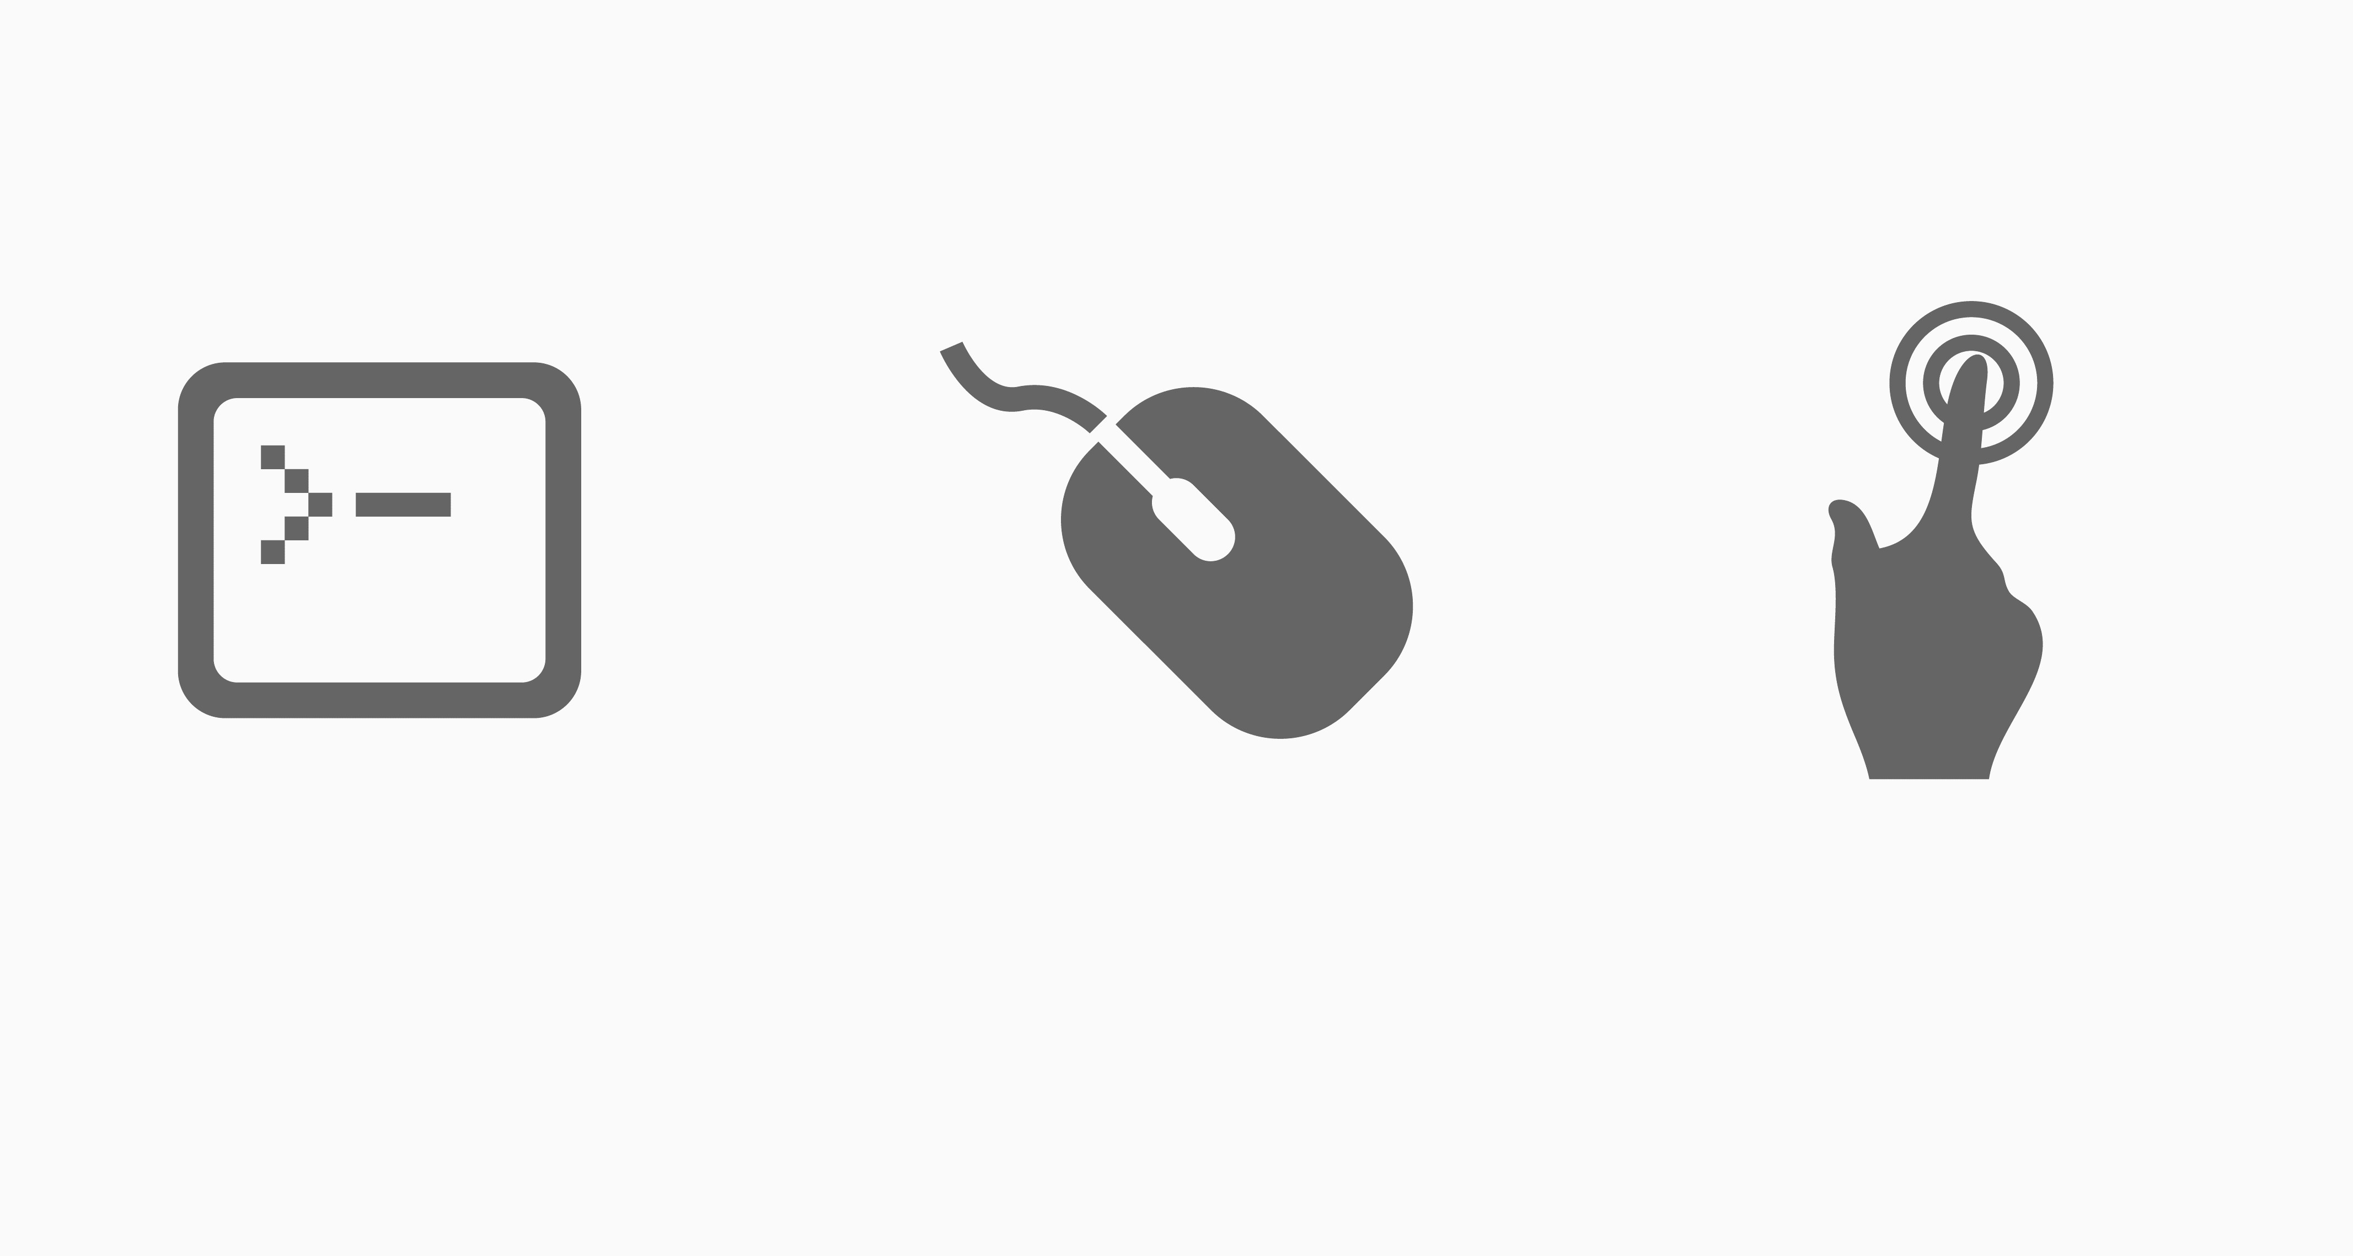
CLI > GUI > NUI
TEXT
GRAPHICS
OBJECTS
Recall
Recognition
Intuition
Directed
Exploratory
Contextual
High-low
Double medium
Fast few
Disconnected
Indirect
Unmediated
Static
Responsive
Evocative
Notes:
Dr. Neil to talk through the slide
Sankar to ask: So, Dr. Neil, is this brand new that we brought all of these things together?
Dr. Neil to talk about the history

Slide 5
Design Pillars
Social
Seamless
Spatial
Notes:
Dr. Neil will talk about the this session

Slide 6
Design Pillars
Social
Seamless
Spatial
Better with more people
Engages all
Emotive
Notes:
Dr. Neil will talk about the this session

Slide 7
Design Pillars
Social
Seamless
Spatial
Feels natural
Integrates with your environment
Walk up and use
Notes:
Dr. Neil will talk about the this session

Slide 8
Design Pillars
Social
Seamless
Spatial
Zoom and focus
Implied physicality of the space (It is a large screen!)
Leverage spatial memory
Notes:
Dr. Neil will talk about the this session

Slide 9
Design Considerations
Notes:
Don’t put a menu right at the top

Slide 10
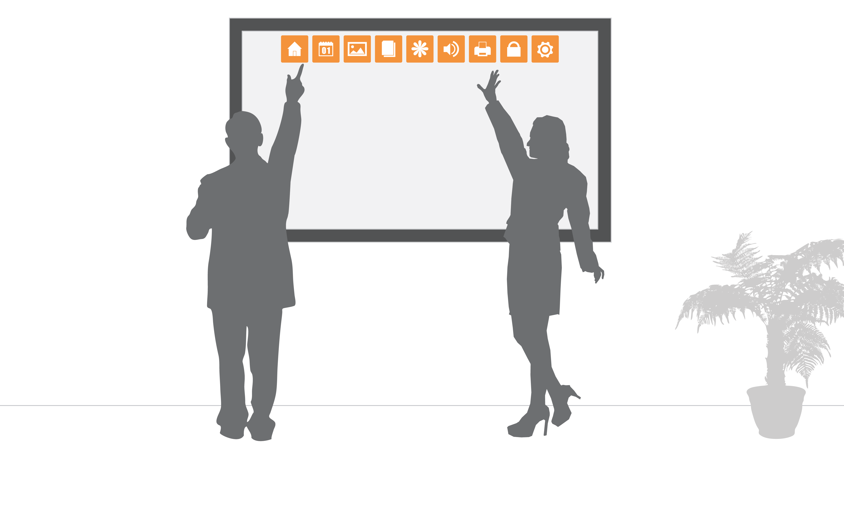
Accessing a menu
Notes:
Don’t put a menu right at the top

Slide 11
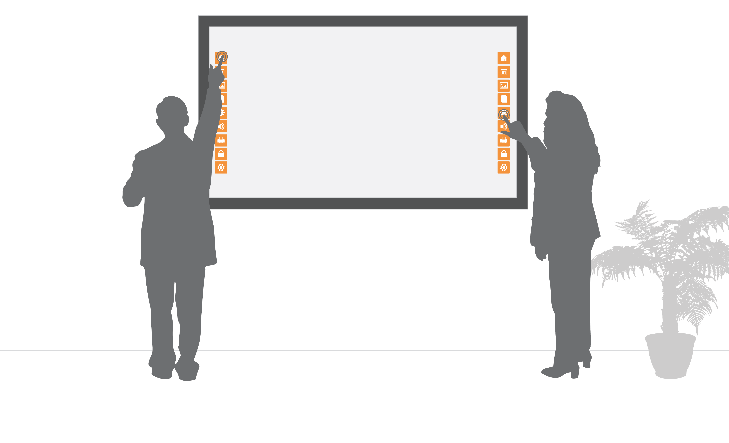
Accessing a menu
Notes:
Do – put a menu on the sides or both sides

Slide 12
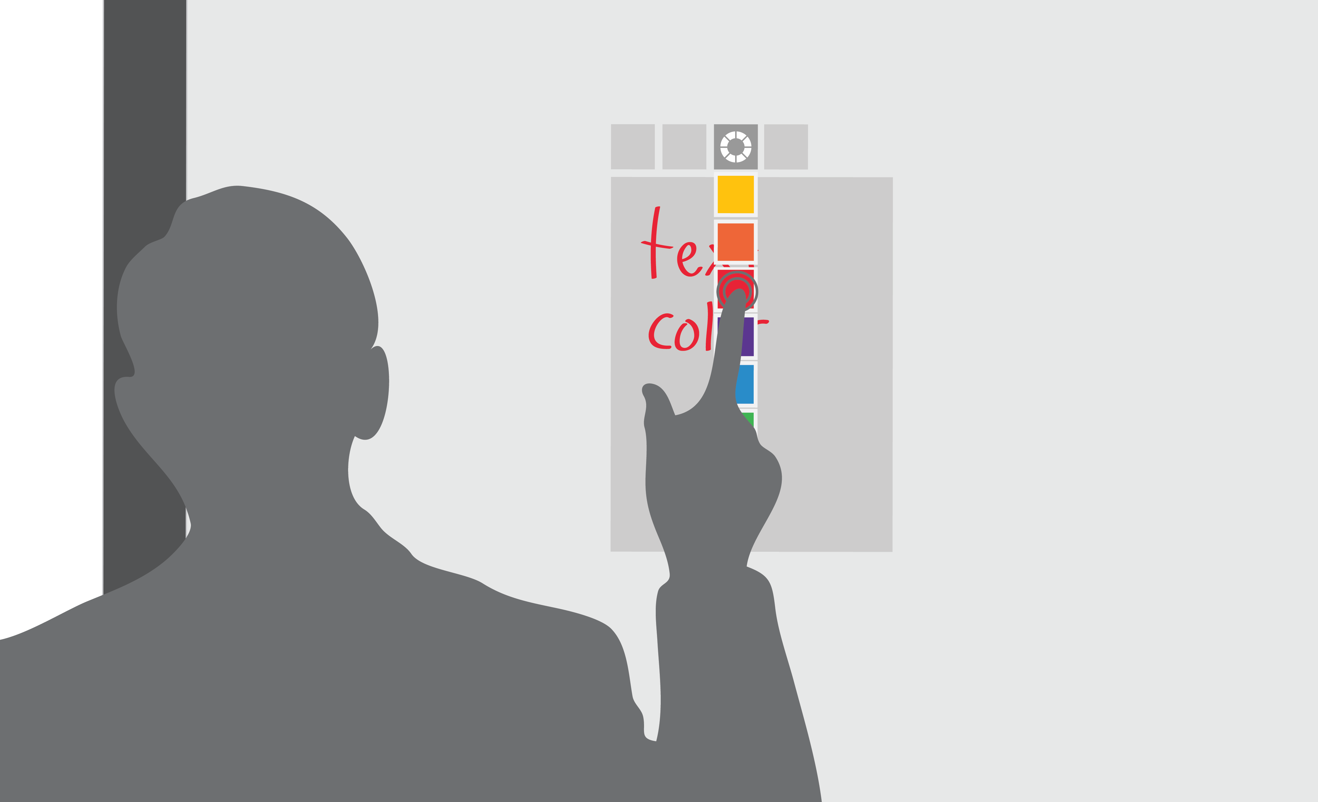
Avoid Occlusion
Notes:
Don’t have hand cover content when editing it

Slide 13
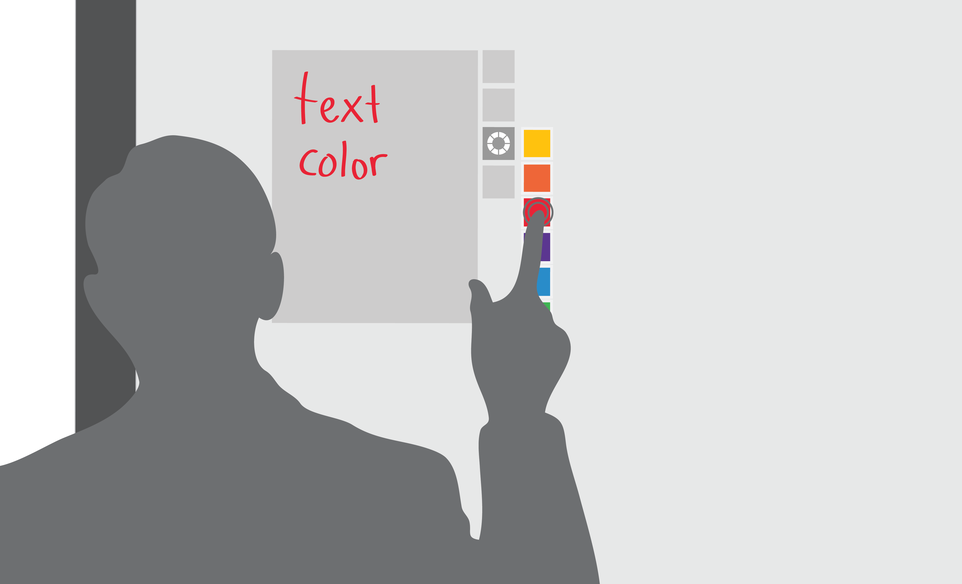
Avoid Occlusion
Notes:
Do – allow users to see the content they are editing

Slide 14
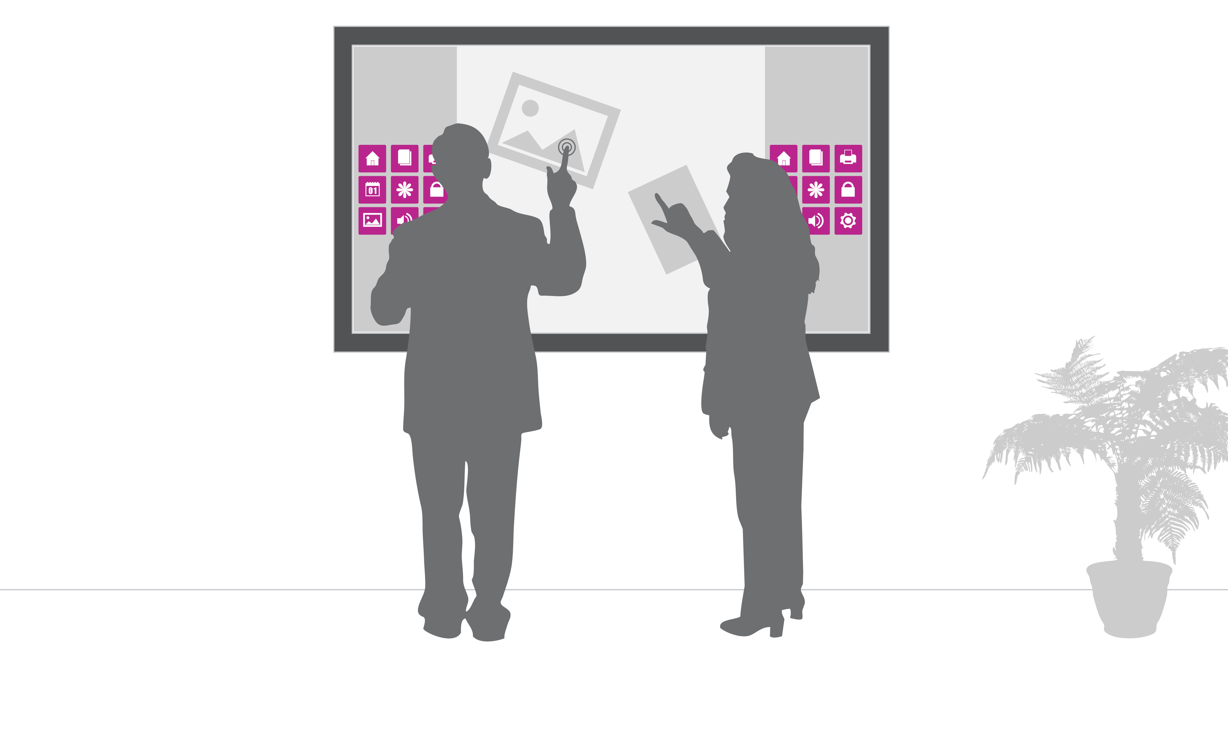
Scale
Notes:
Don’t allow too much space for controls

Slide 15
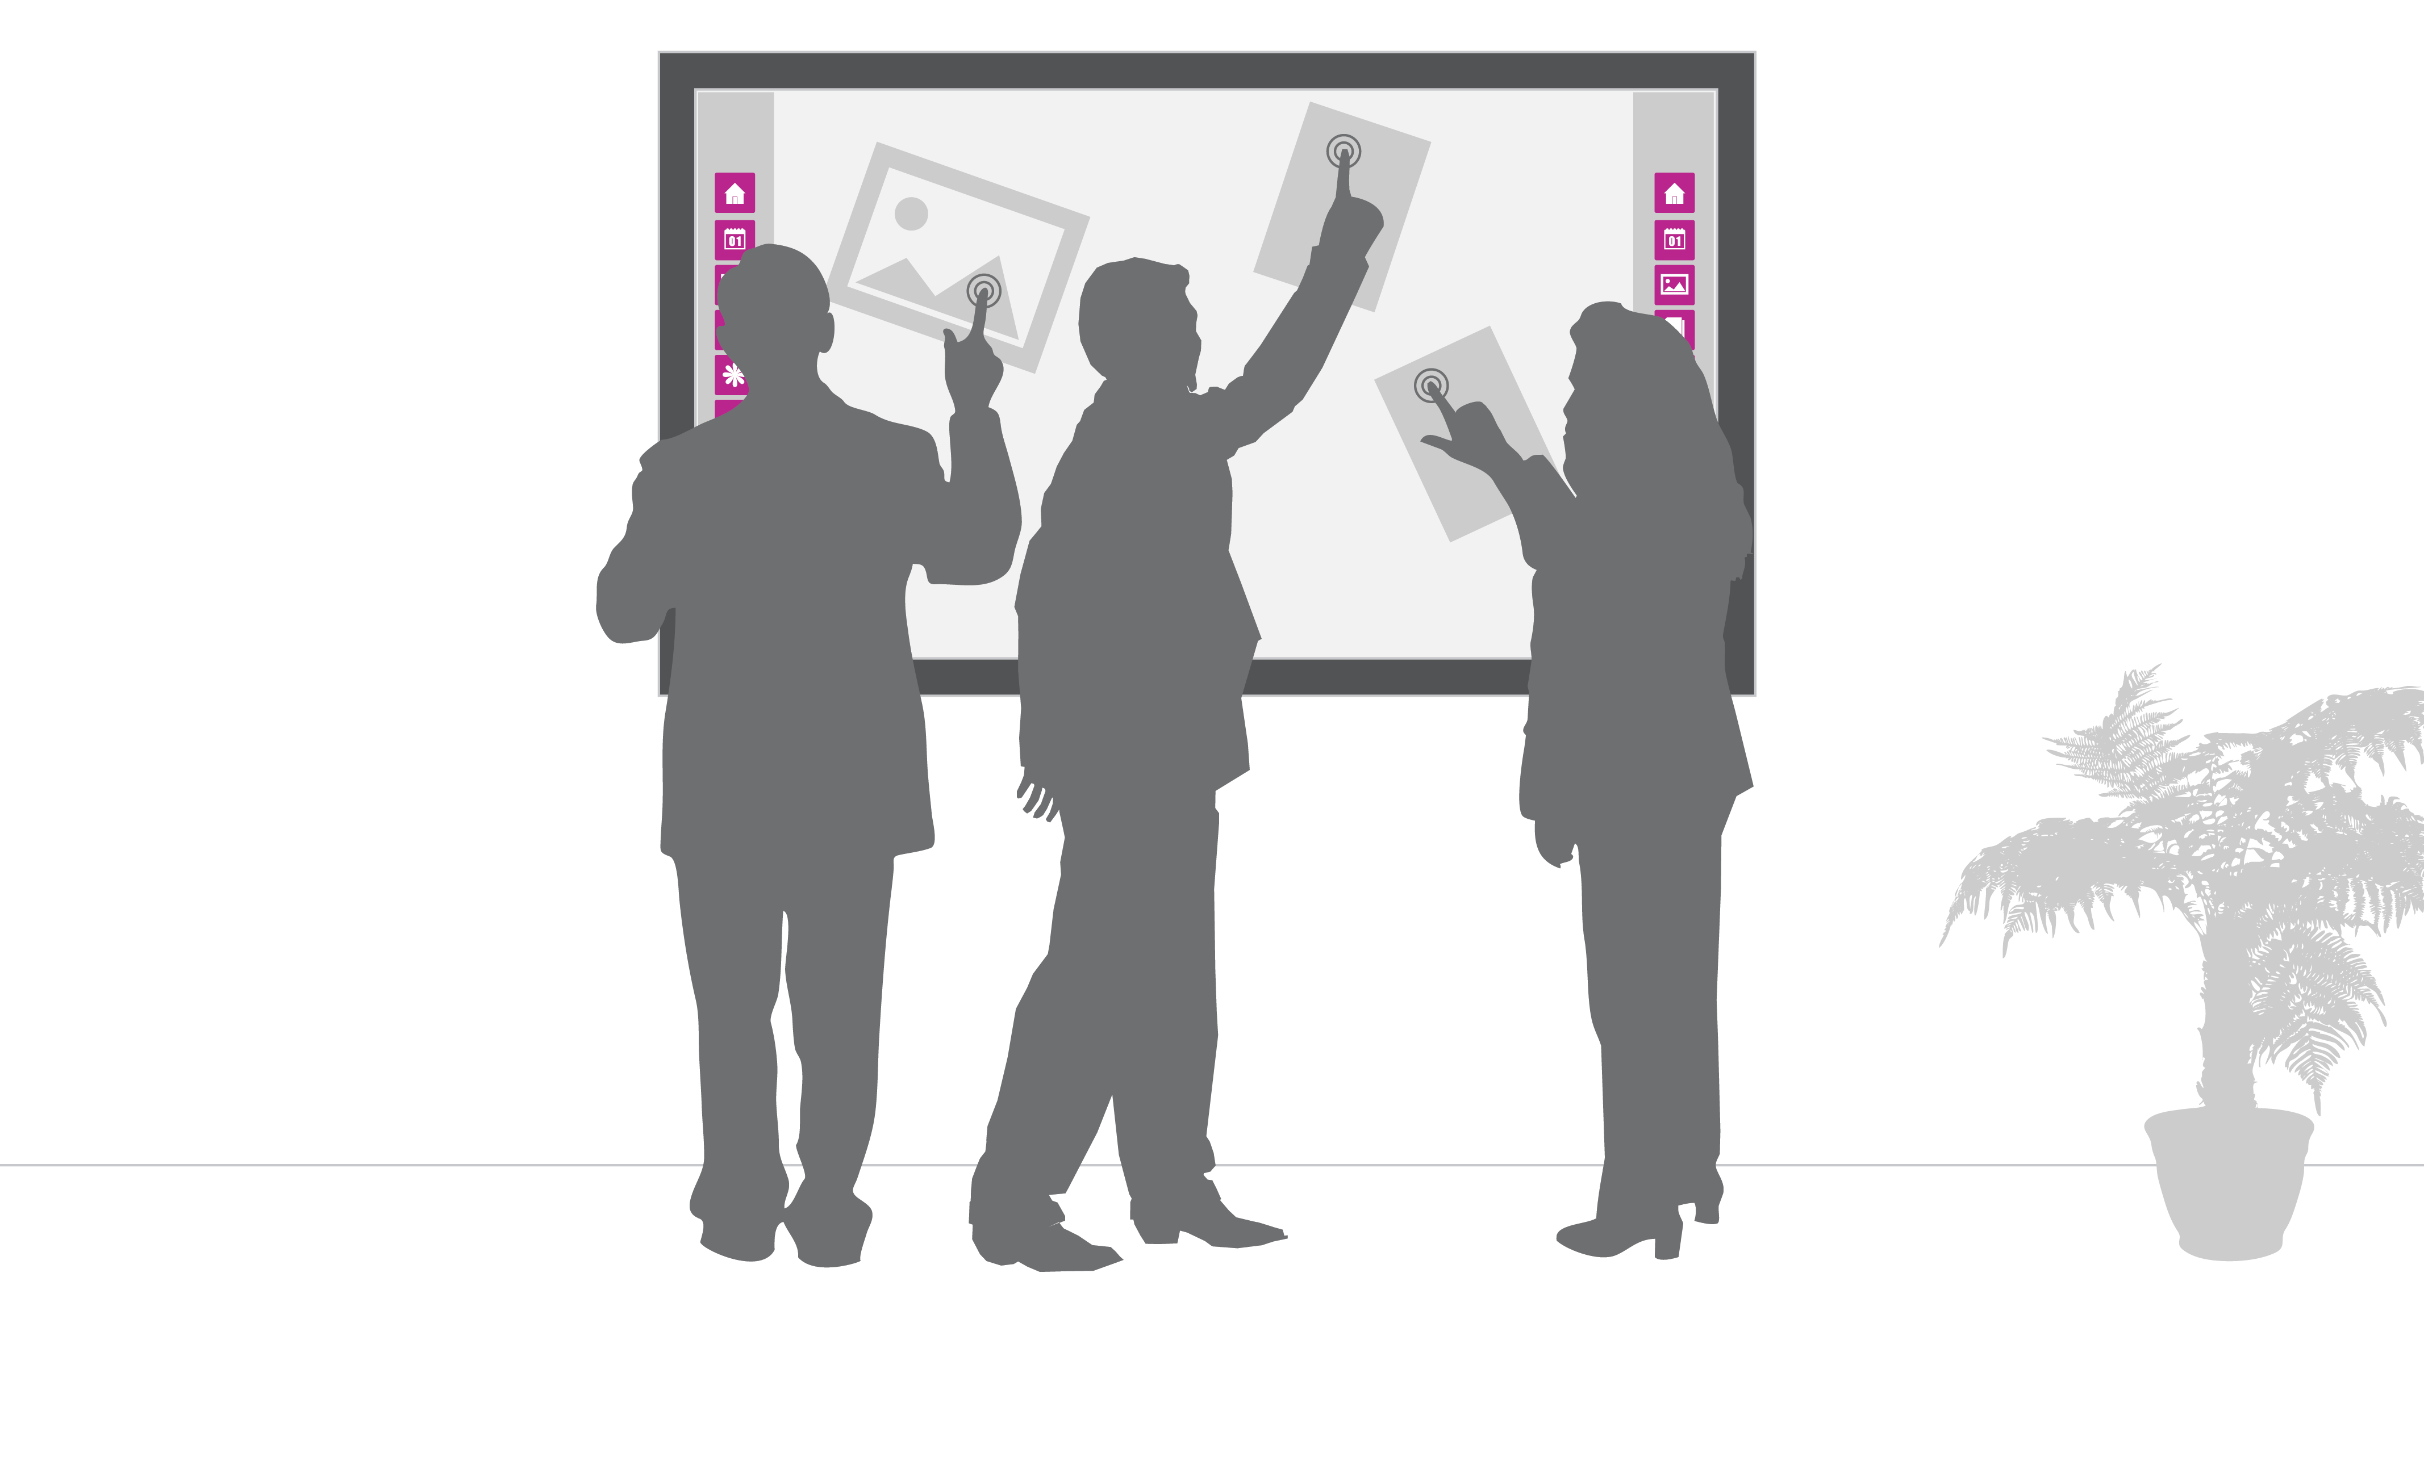
Scale
Notes:
Do – allow plenty of space for activity

Slide 16

Design for multiple users
Notes:
Don’t design for a single user

Slide 17
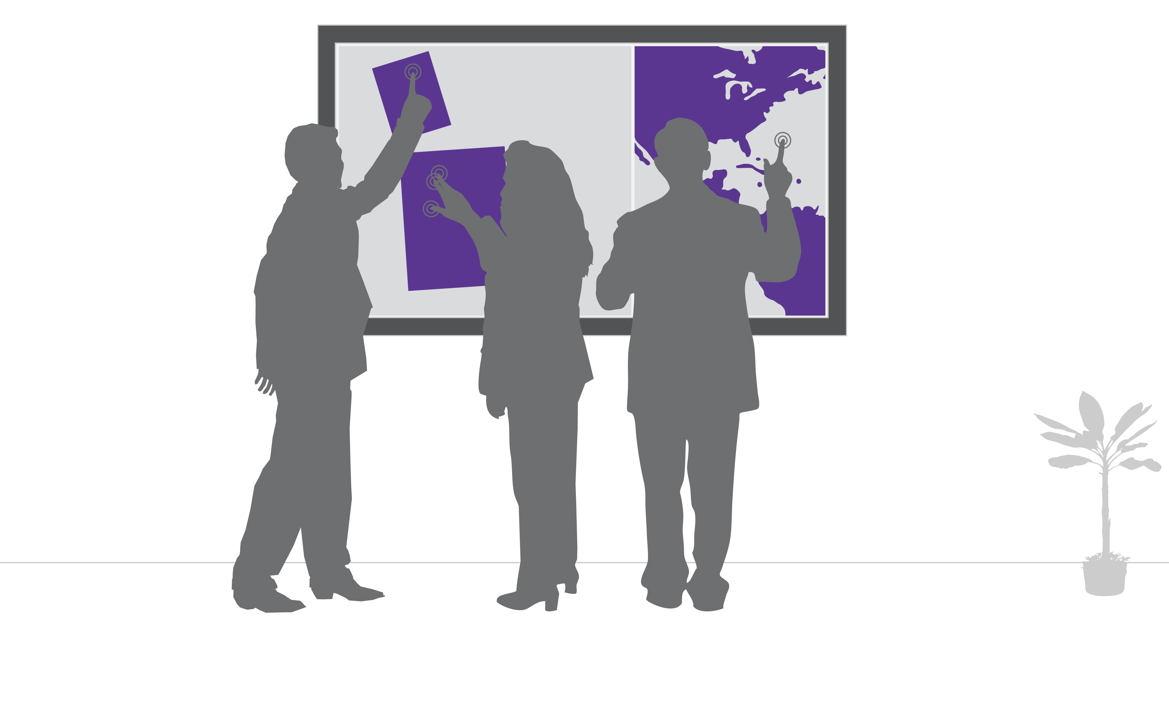
Design for multiple users
Notes:
Do – allow simultaneous input. More than one user can manipulate content

Slide 18
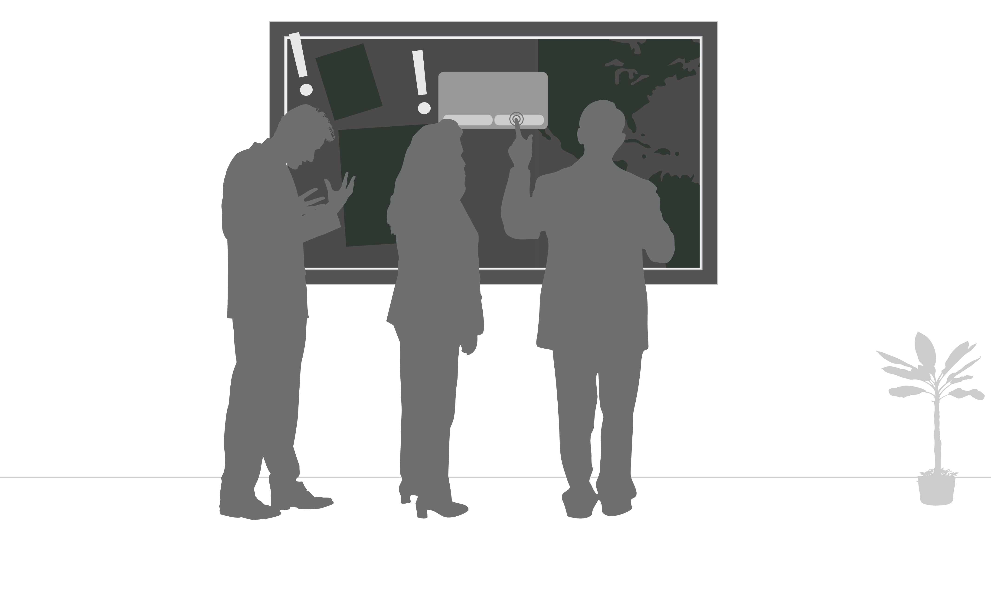
Avoid modality
Notes:
Don’t block other users experiences

Slide 19
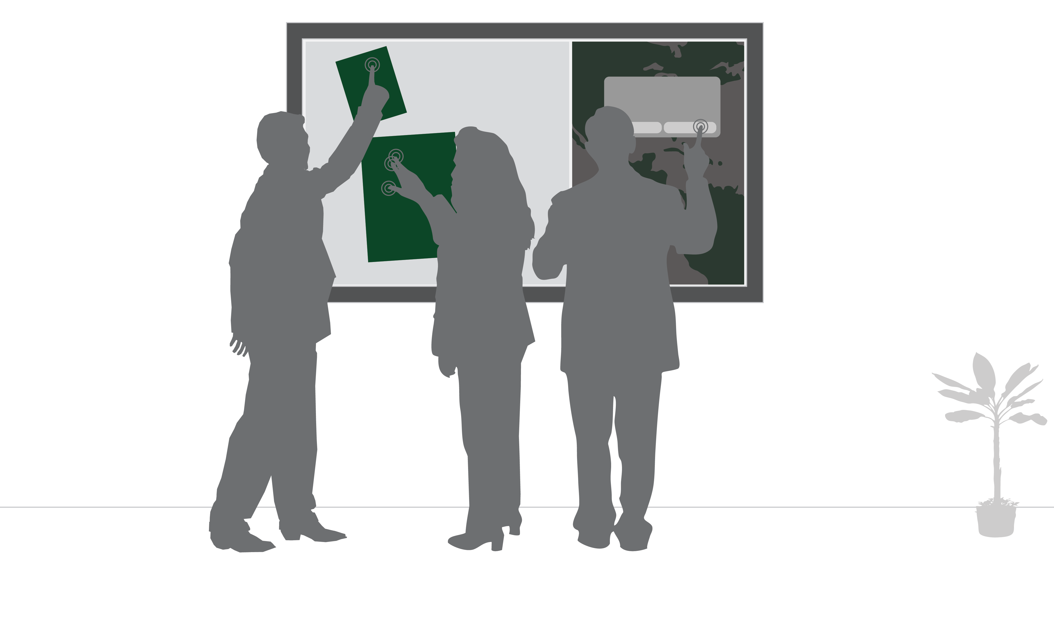
Avoid modality
Notes:
Do – design an experience that will not effect other users

Slide 20
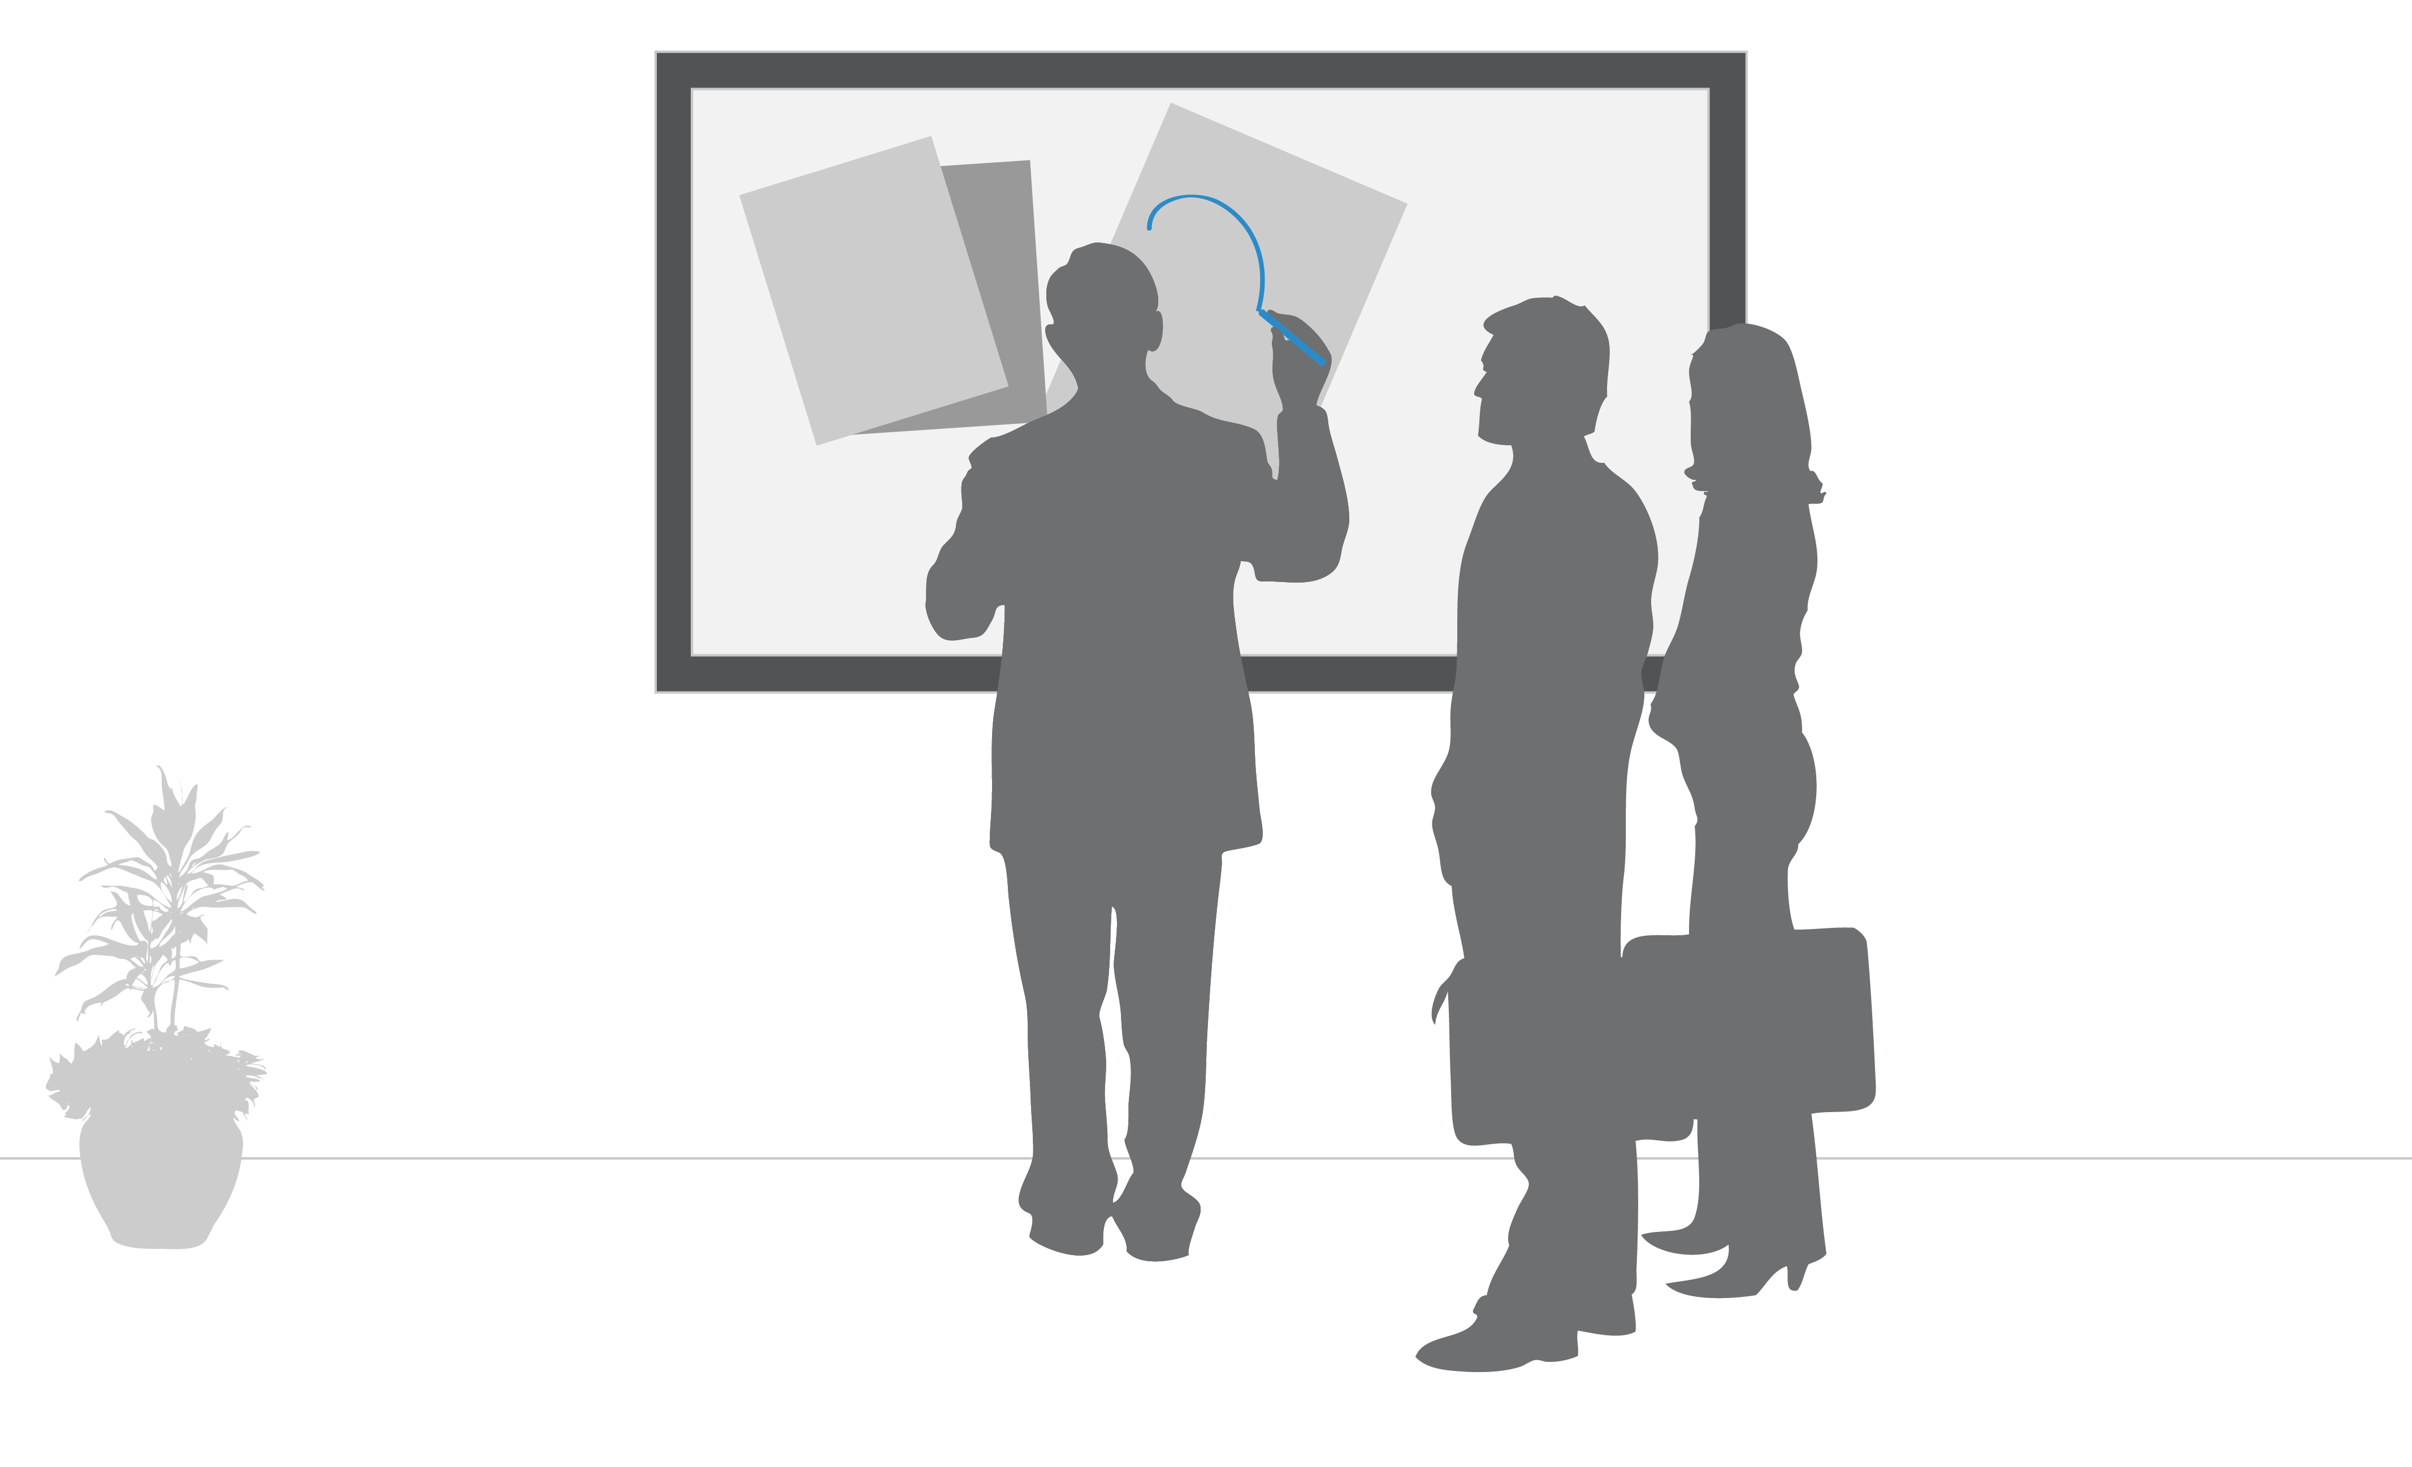
Multi-stylus
Notes:
Don’t restrict to single stylus input

Slide 21
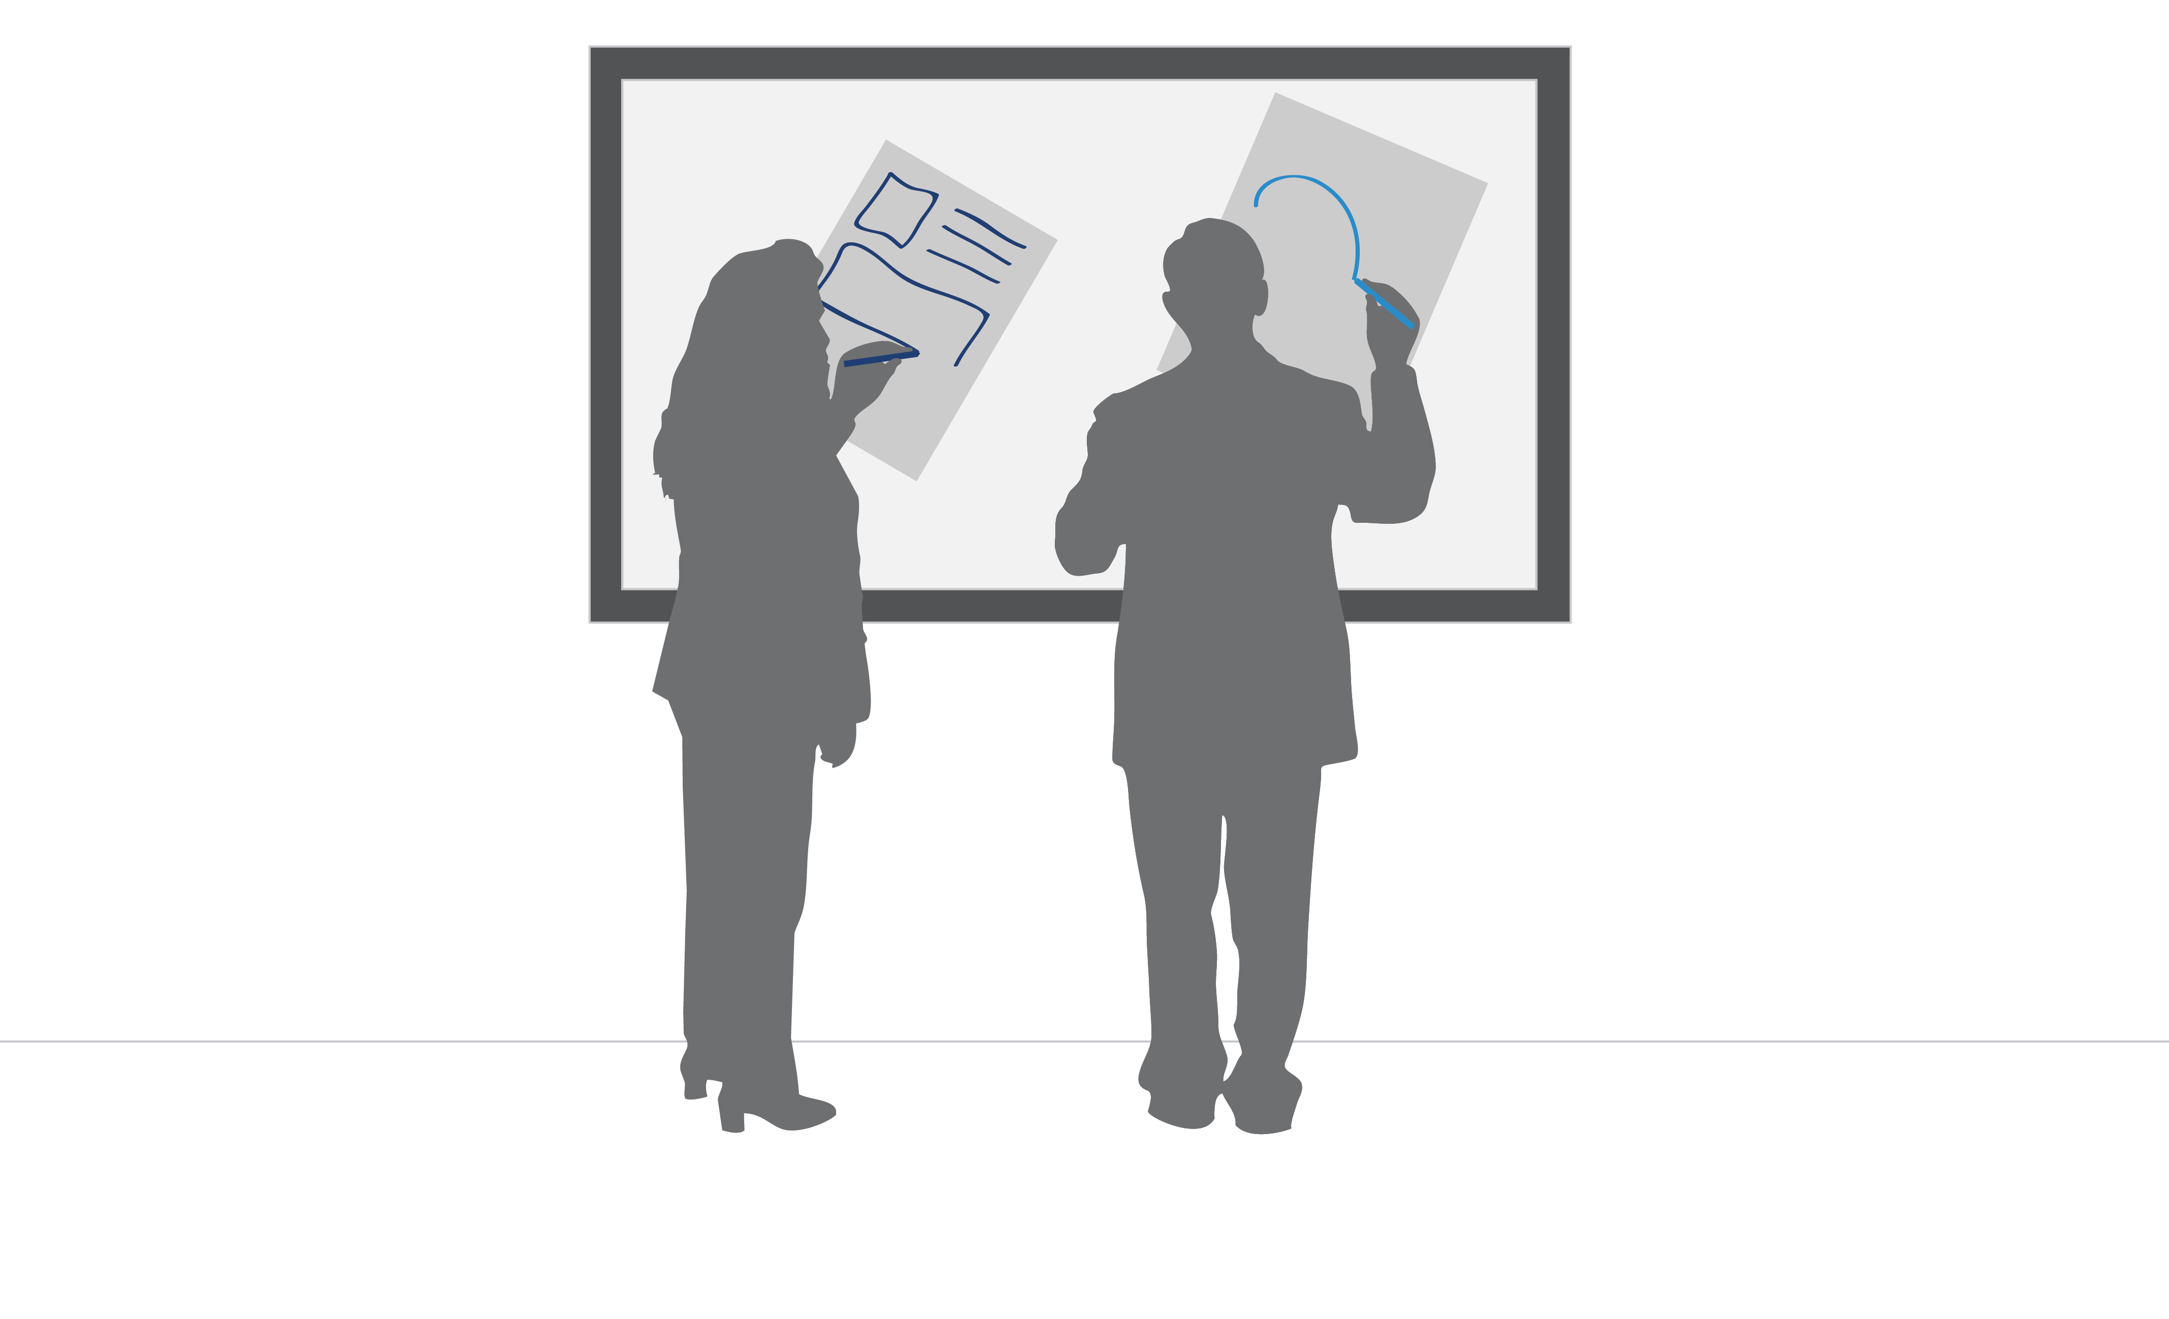
Multi-stylus
Notes:
Do – allow multiple users to use a stylus and change style of pen

Slide 22
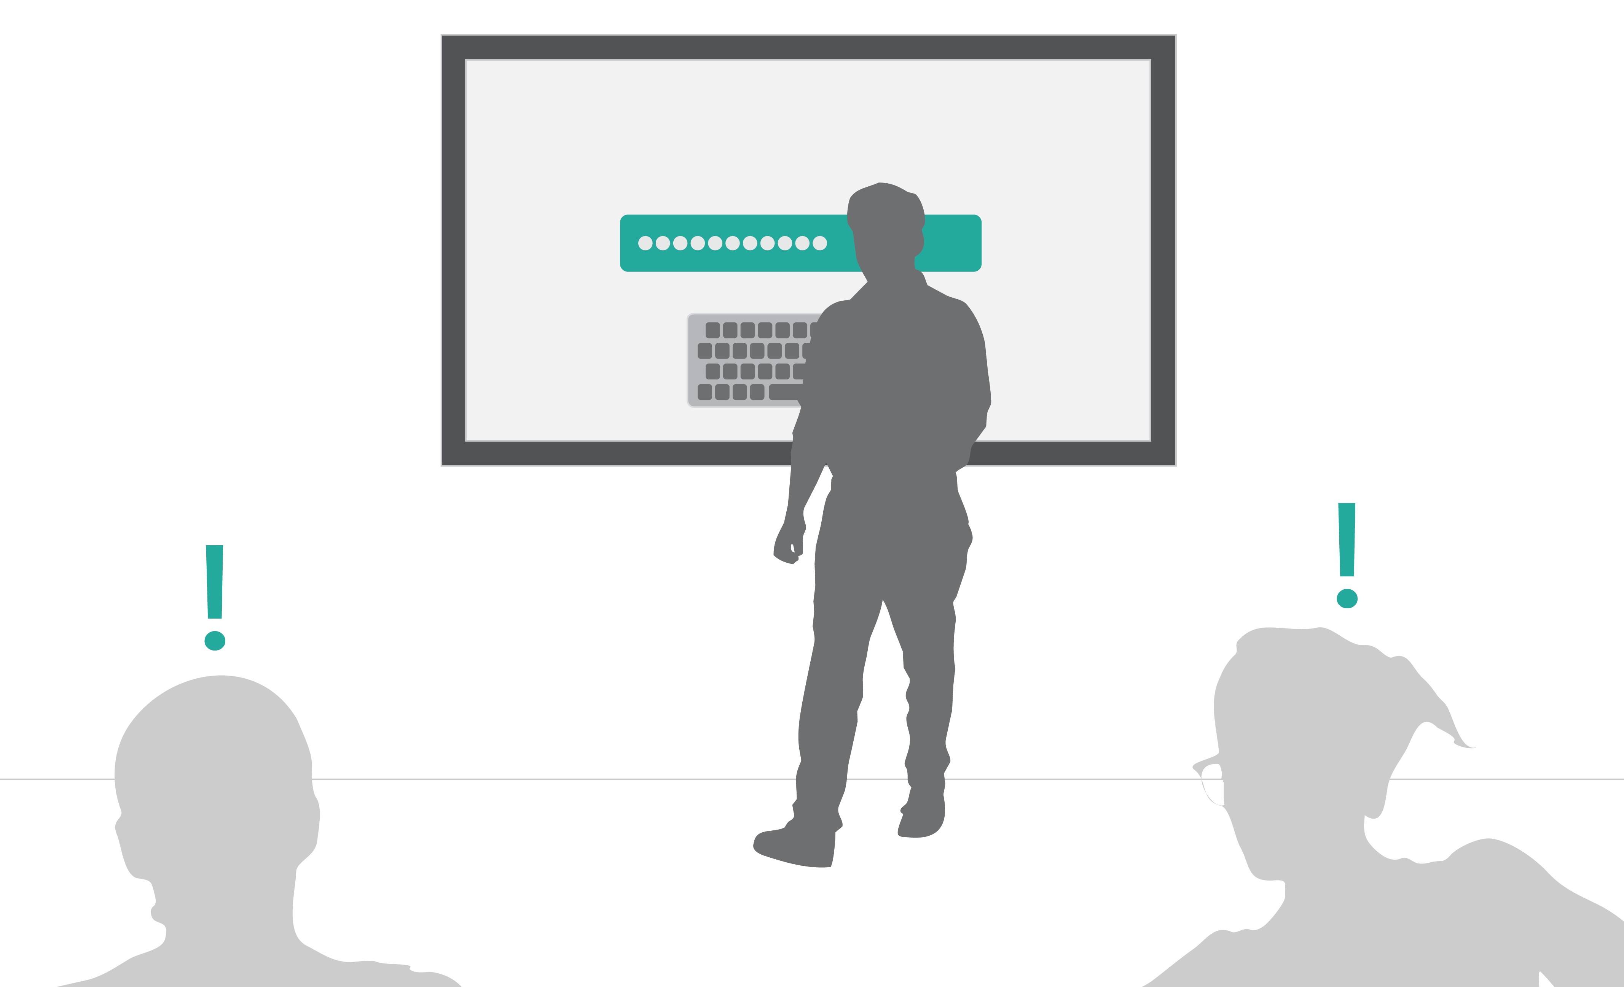
Authentication
Notes:
Don’t allow only one user to login

Slide 23
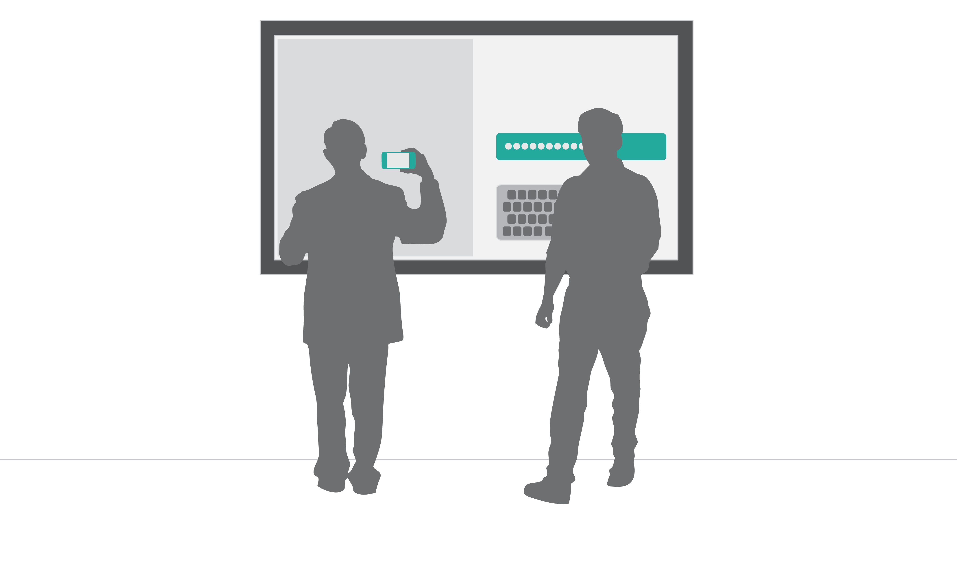
Authentication
Notes:
Do - allow multiple users to login to get content up in different ways (NFC, login)

Slide 24
Good UWP Design plus:
Allow users to easily access menus
Design for inclusion, not occlusion
Consider the scale of things
Design for multiple users
Avoid modality
Allow multi-stylus input
Allow multiple users to login in a session

Slide 25
Further considerations

Slide 26
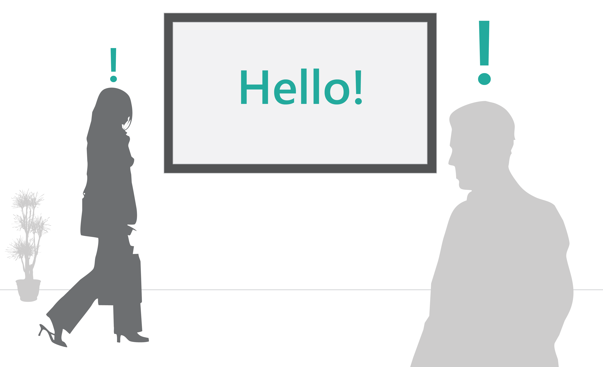
Engagement should be obvious
Notes:
Walk up and use

Slide 27

Interface is beyond keyboard and mouse

Slide 28
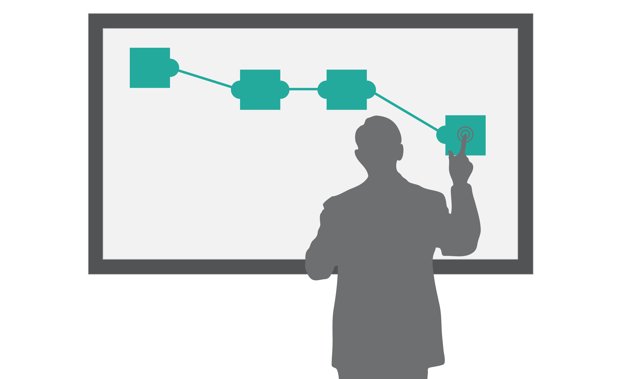
How do items on the screen relate to each other

Slide 29
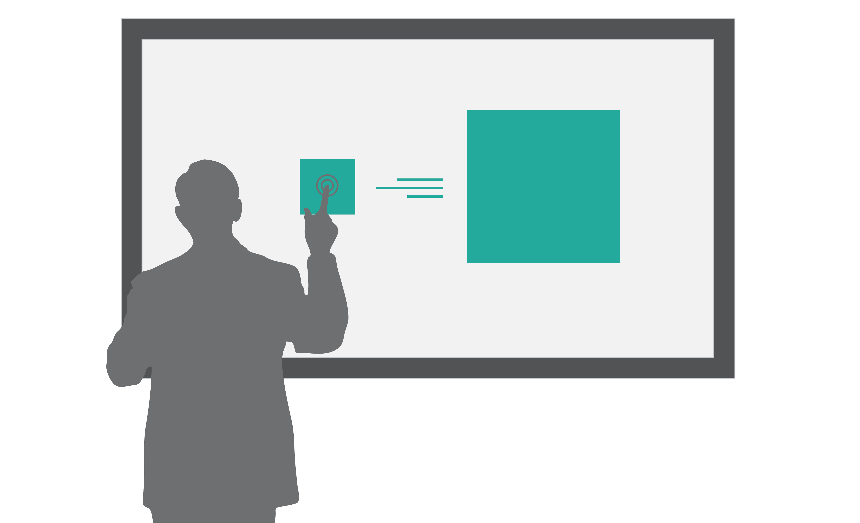
Clear transitions
Notes:
How do things get on the screen

Slide 30
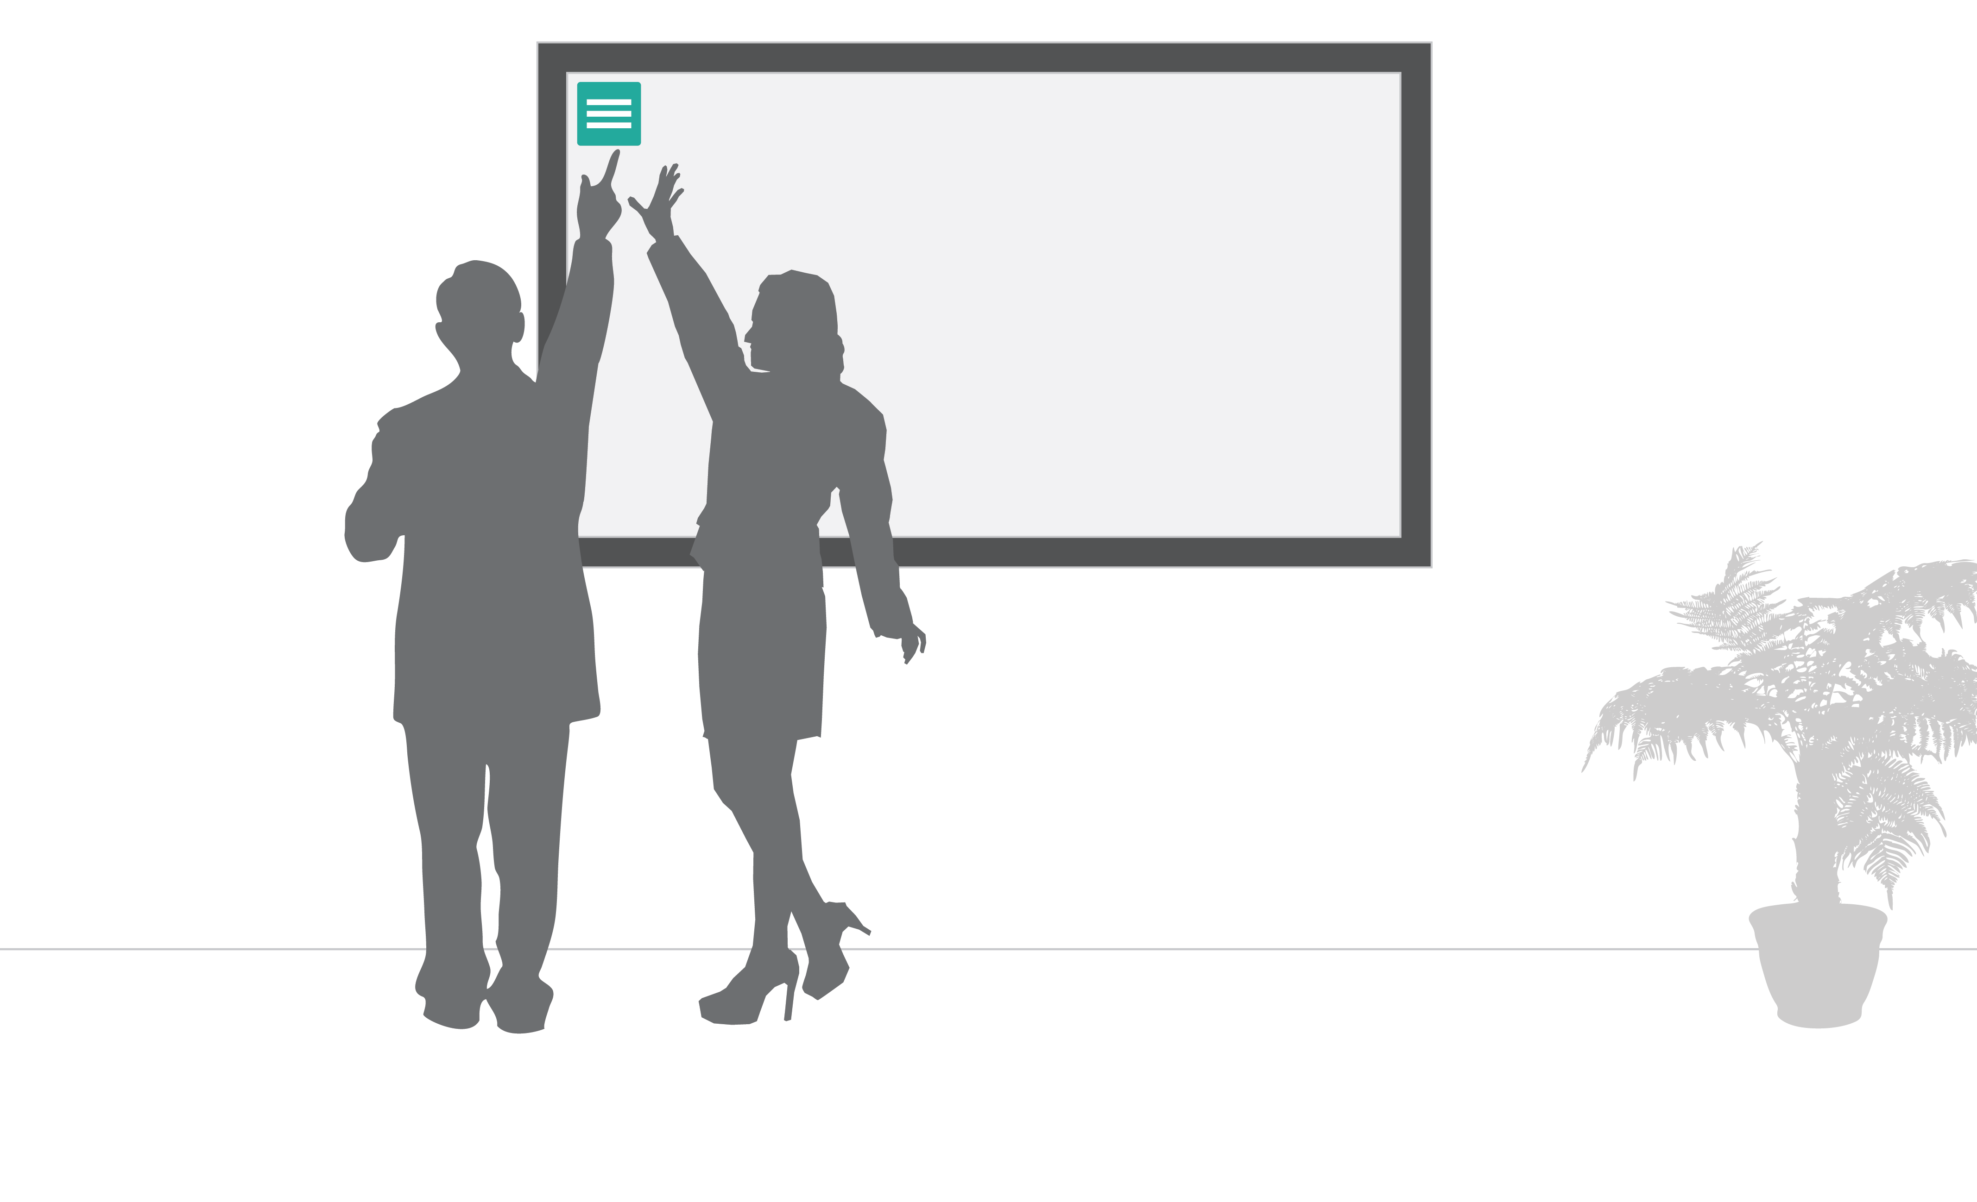
How do you use interface items and get to interface items

Slide 31
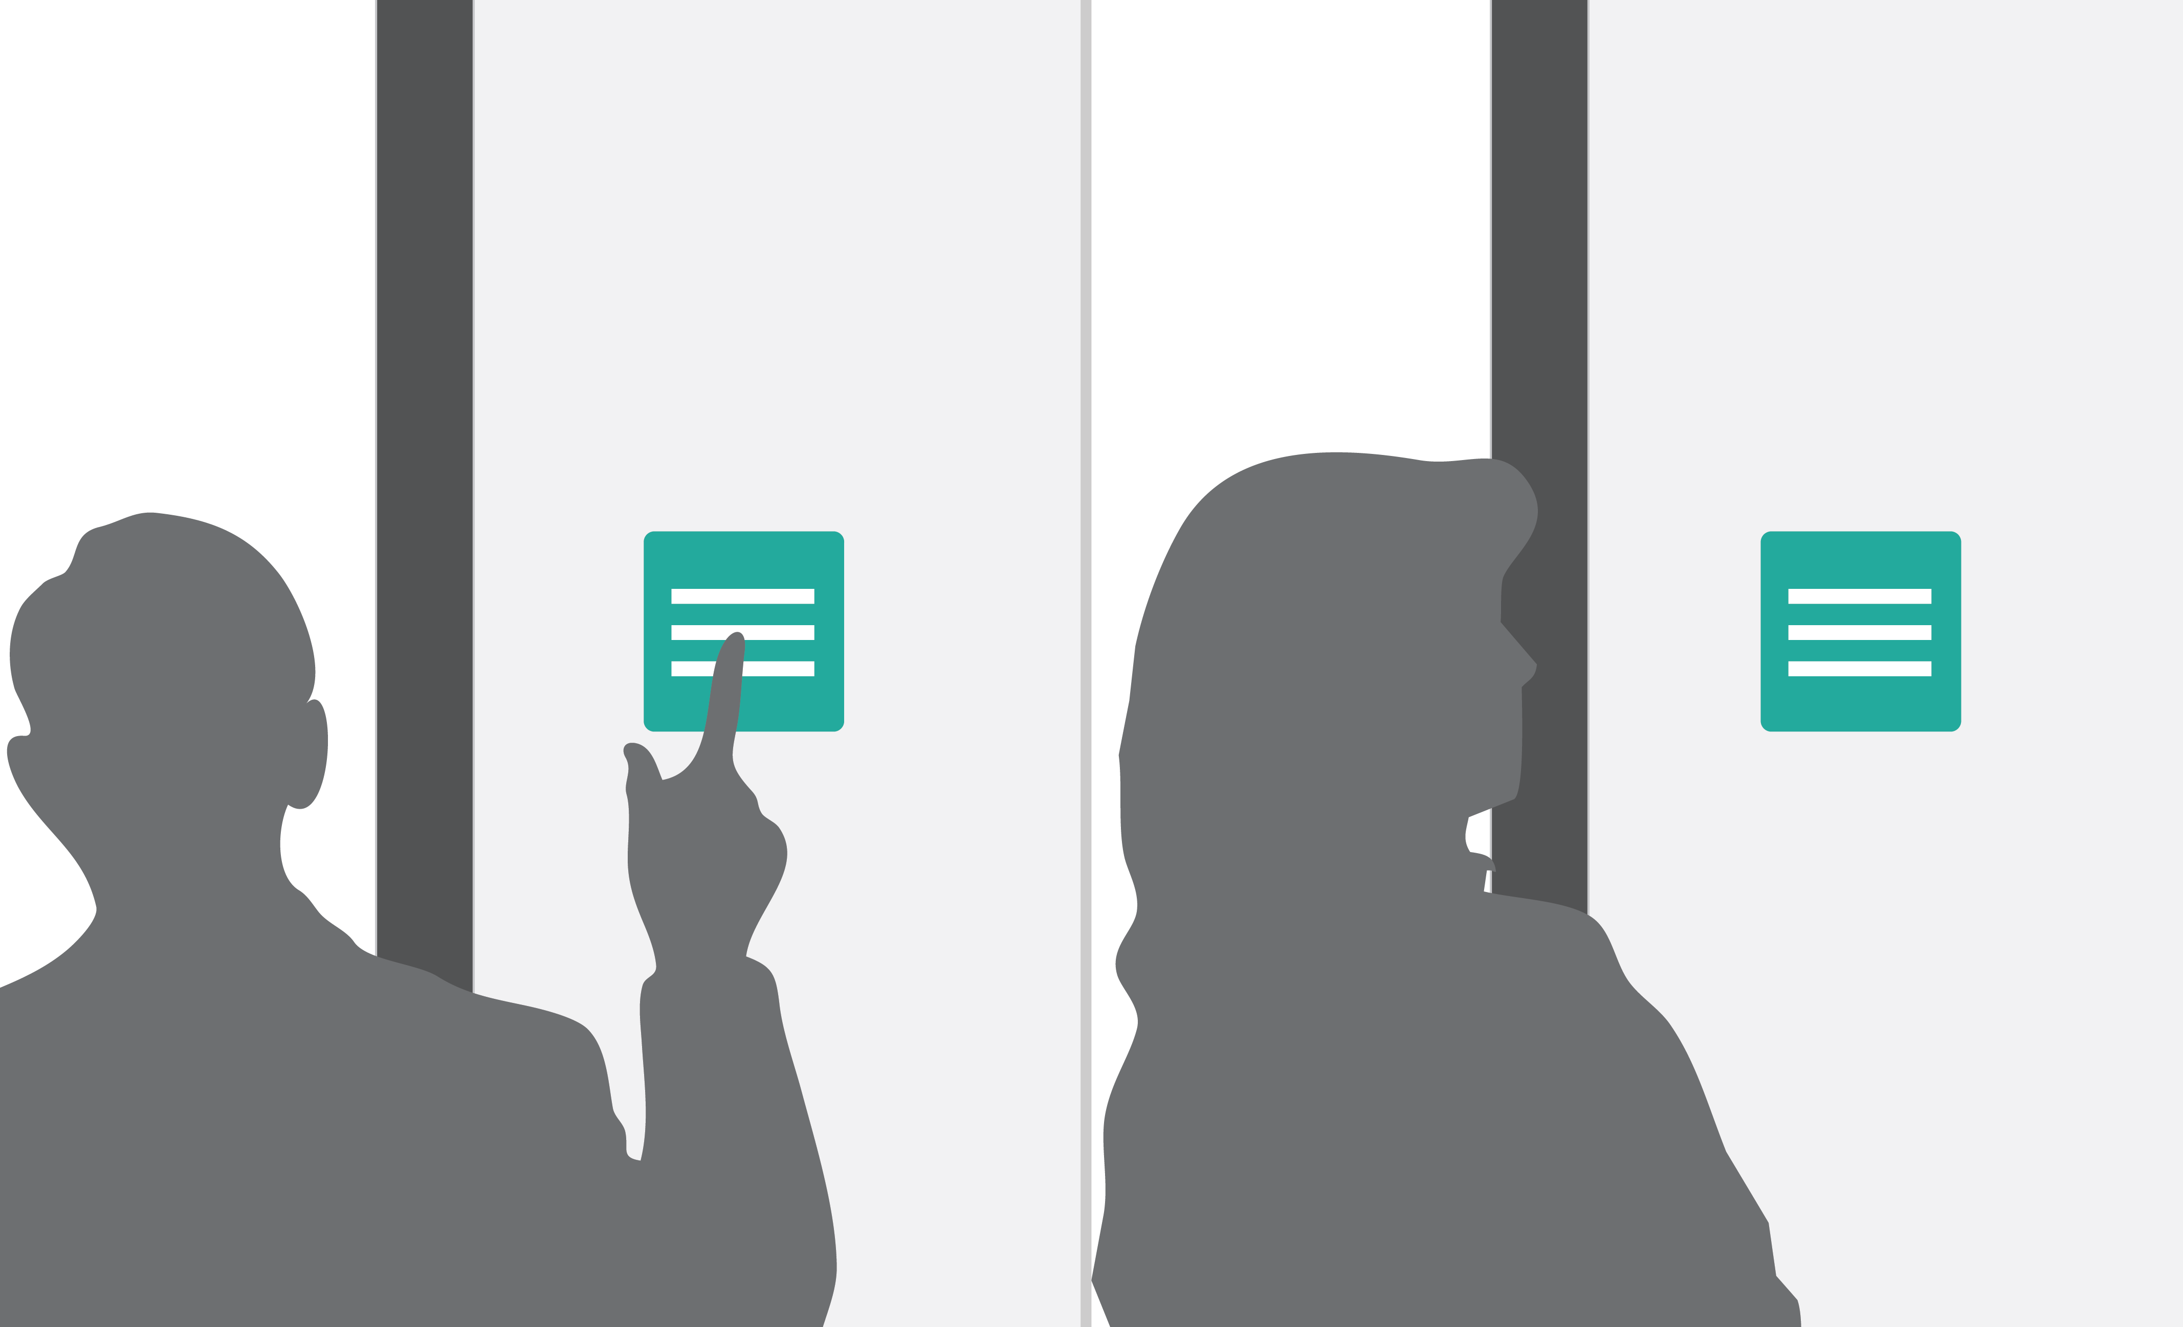
Spatial memory
Notes:
Menus should not move

Slide 32
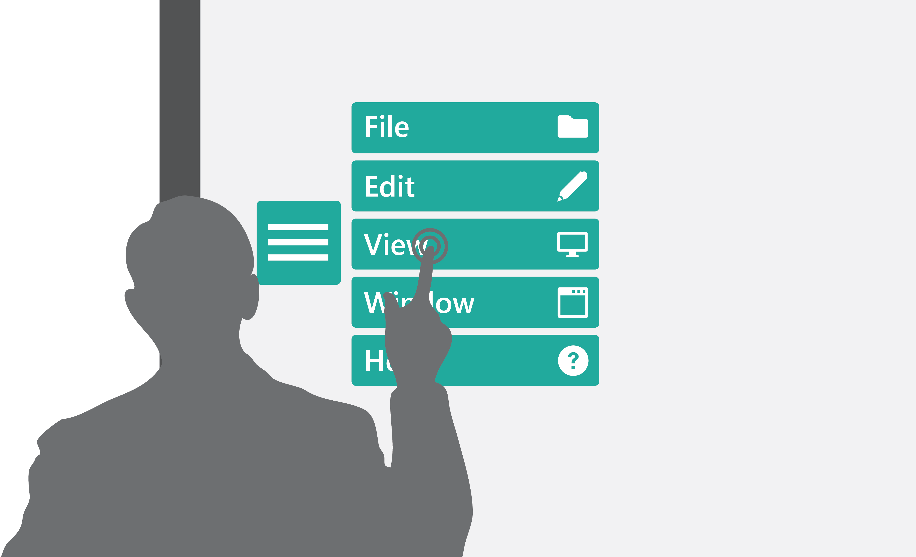
Consistency of UI
Notes:
Europe vs US cars

Slide 33

Mouse is more precise than finger, but GUI is single user

Slide 34

Icon sizes

Slide 35
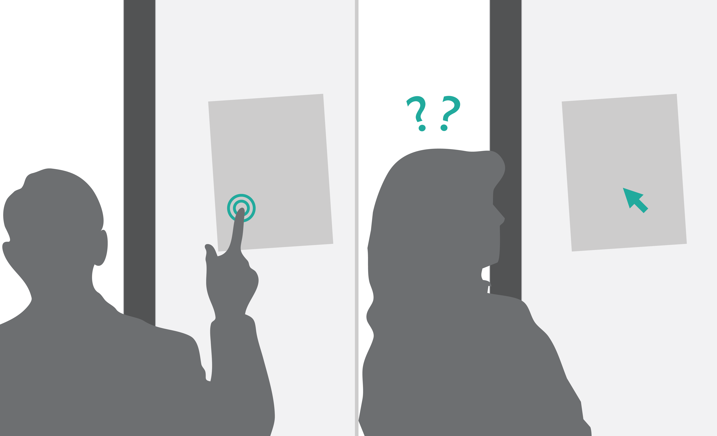
Direct manipulation – Indirect manipulation
Notes:
Direct manipulation - Touch is obvious
Indirect manipulation - Needs to be learned

Slide 36
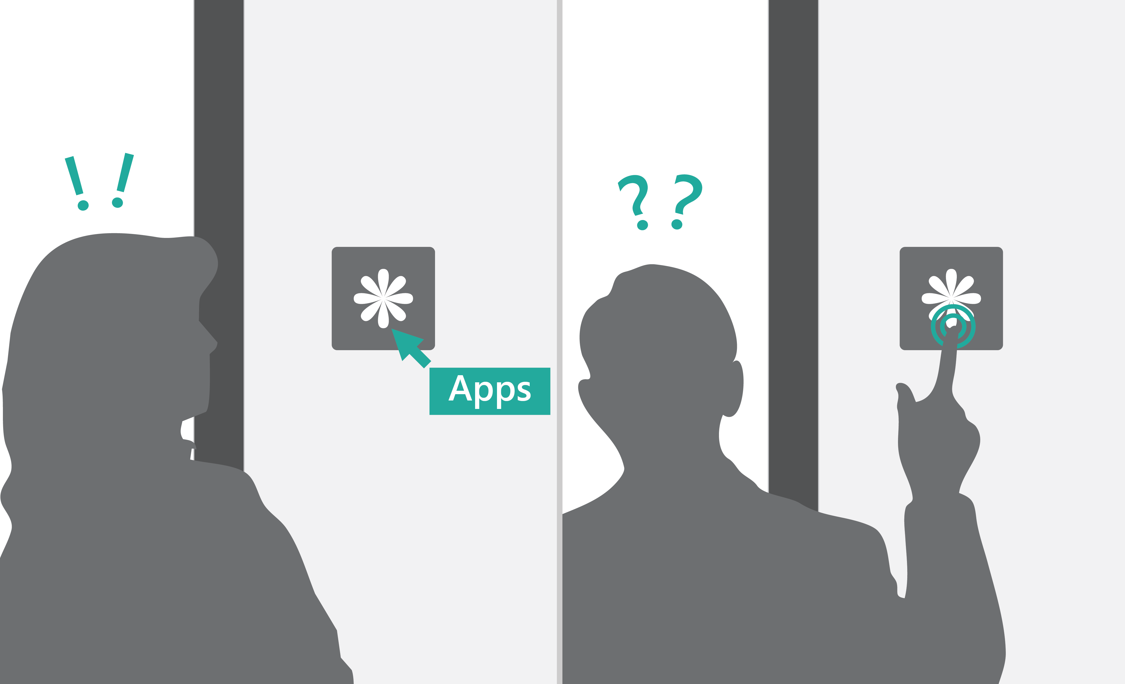
No hover
Notes:
Icons need to be obvious

Slide 37
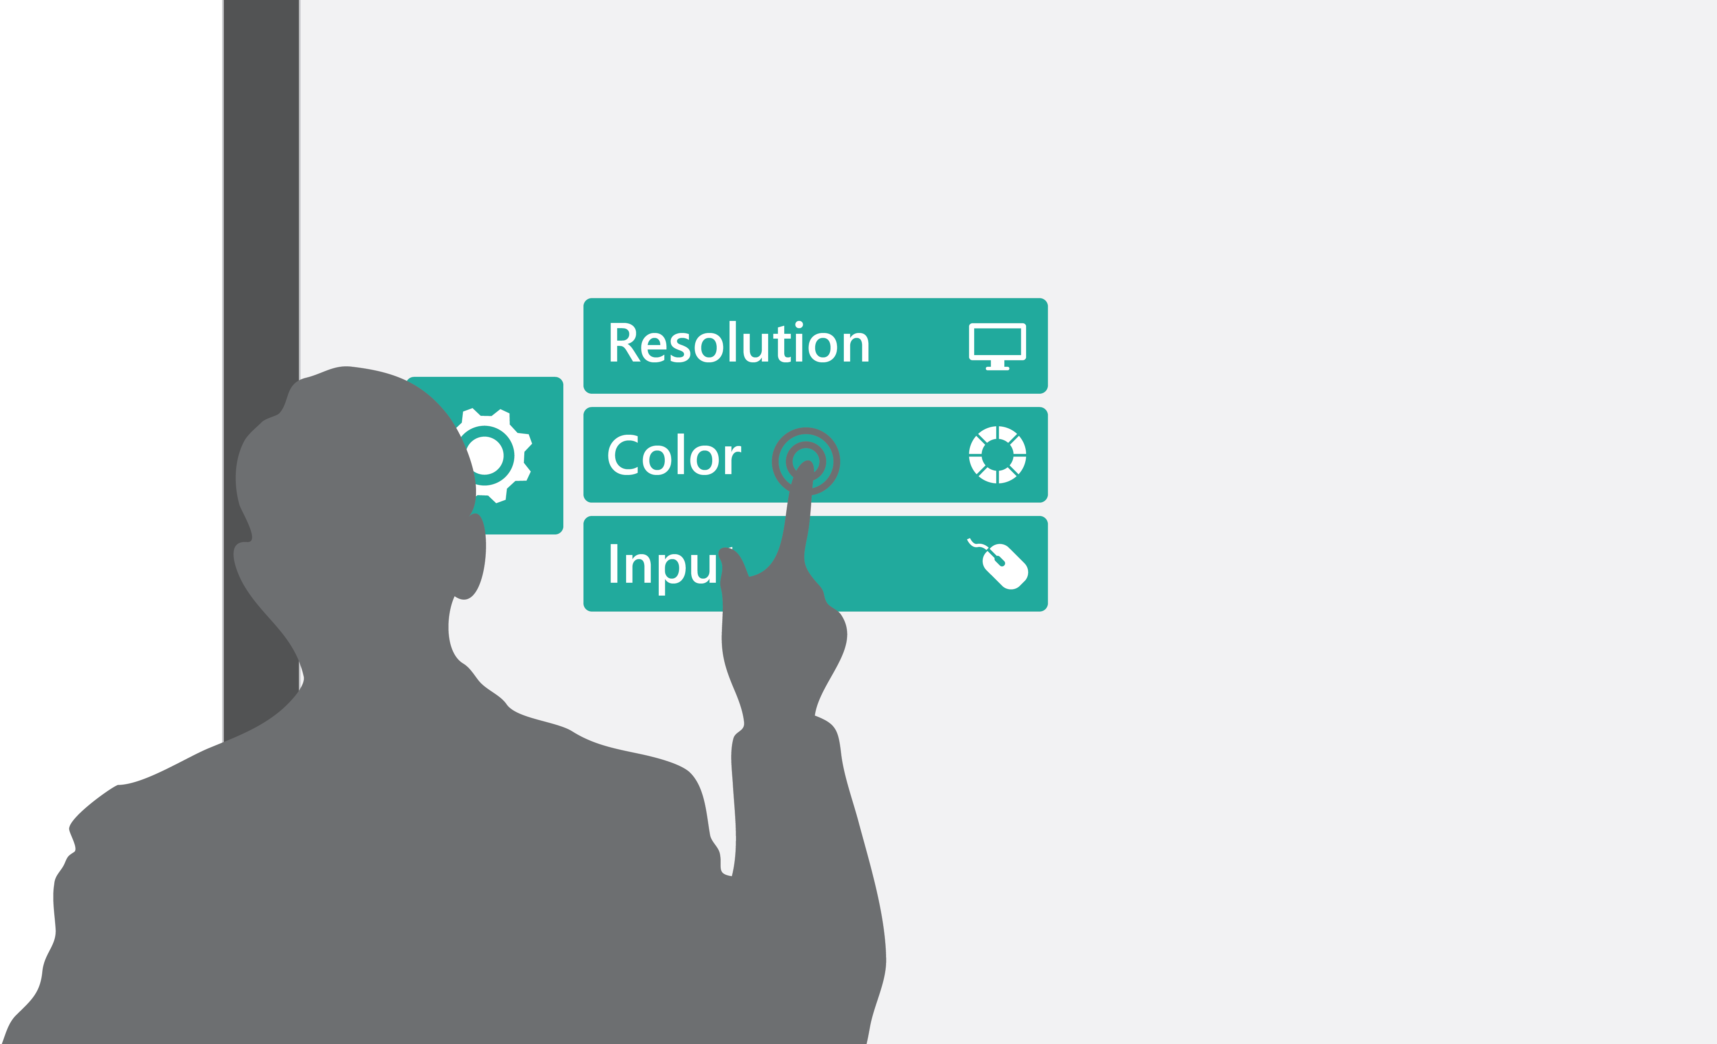
Menu system should be user friendly and touch friendly

Slide 38

Always provide feedback when touch occurs

Slide 39

Experience should improve when more people engage

Slide 40
Thank you
Notes:
Pen and touch – multimodal
FAQ – how to know I am on HUB – know on Windows Team

